Slide 1
PAPER PUBLICATION FACILITY SERVICES
SYED TASHMIM AHMED

Slide 2
Commencement
Paper Publishing distributes research and scholarship whether it could be relative to business or academy. Most academic work is published in academic journal articles, books or thesis' form. The part of portfolio written output that is not formally published but merely printed up or posted on the Internet is often called "grey literature". Most scientific and scholarly journals, and many academic and scholarly books, are based on some form of peer review or editorial refereeing to qualify texts for publication. Peer review quality and selectivity standards vary greatly from journal to journal, publisher to publisher, and field to field.

Slide 3
Prosperity
There is great relevance to research in Business. Apart from ensuring an in-depth knowledge over a topic, scientific and historical research papers also contribute to the world of knowledge. These journals or papers become the helping hands for the client in future guiding and helping them to rely on appropriate firm/company. Industry need to understand the role of scientific research and portfolio publishing in society and the importance of both in building successive portfolio as it will ultimately reward them in return.

Slide 4
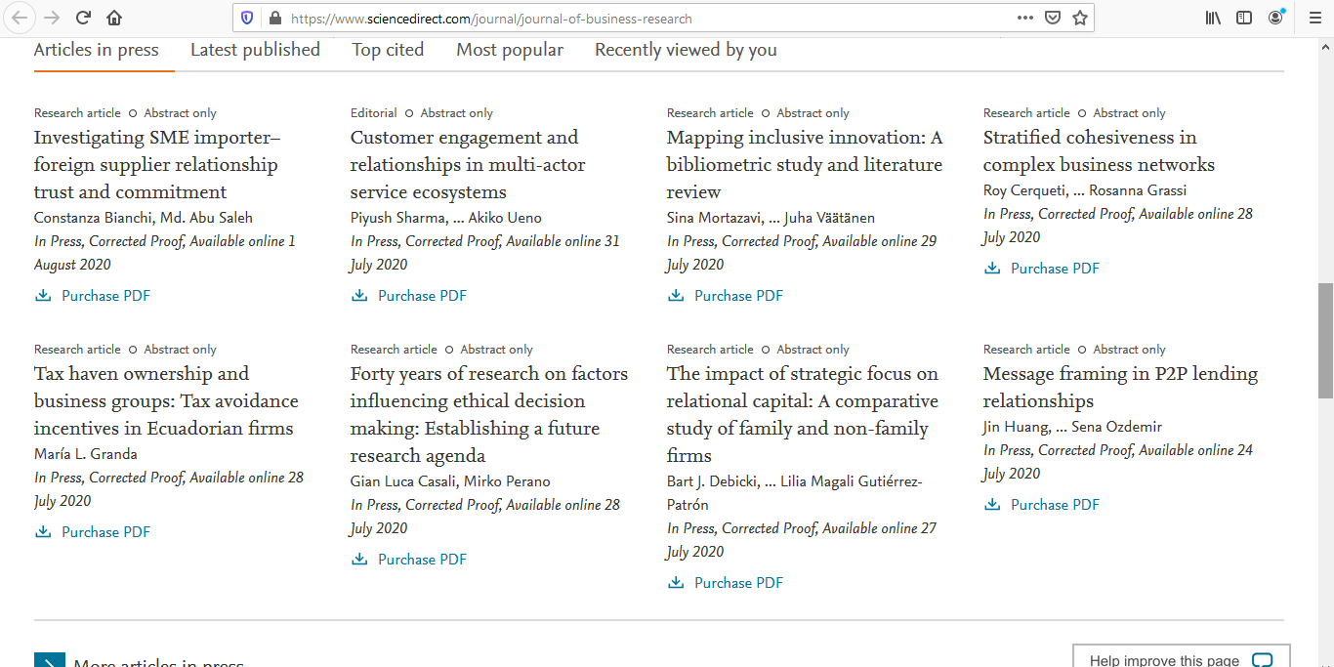
Illustration

Slide 5
Our Services
With regards to scholarly composition, writing your thoughts down is just the initial step. You likewise need to send out the correct vibe, persuade your users of your contentions, and observe the norms and shows of your field. Fortunately, such services are here to help! group of scholarly editors can assist you with communicating your thoughts and regard the guidelines of scholastic composition, so you can turn in your paper with certainty.
These facilitations can edit and alter all your examination related reports, with 100% joy ensured.

Slide 6
Our Services
Different Standards for different docs i.e.
Thesis
Ph.D. Dissertations
(Admission) essays
Research papers and term papers
Capstone projects
Personal statements
Research proposals
Journal articles
Academic manuscripts

Slide 7
Ease
LANGUAGE
Typos, spelling mistakes, hyphenation errors and other simple mistakes.
Word order, sentence structure, verb tenses, agreement, prepositions, articles and more.
Periods, commas, colons, semicolons, dashes, quotation marks, etc.
ACADEMIC STYLE
Subjective language, inflated and redundant phrases, and overuse of the passive voice.
Acronyms, abbreviations, numbers, equations and Latin abbreviations.
Consistency in English dialect and in style choices.
FEEDBACK
Editors leave queries when the meaning is unclear and when you have to make a style- or content-related choice.
Editors use comments to explain nuanced grammatical rules, suggest improvements and offer general advice.
You receive a personalized improvement letter designed to help you recognize and correct your most common mistakes.

Slide 8
Target
Distribution of pamphlets, menus, business card and other documents related to business promotion to public is quite difficult and also became awkward in this era of digital marketing. Therefore for the purpose of informing users about your business services/product ,writing or publishing papers become appropriate and an efficient medium to communicate with market. Publishing papers provide a broader perspective of specific product in user’s understandings. Portfolio of business/service/product is more clearer in terms of its reliability, sustainability and competence. It is also a huge way out to international market’s user, as publishing paper to international web may lead to communication with entire globe, which could result for your business as a successful decision. Through paper publication not only user but people from different industries and students as well came to know what is new and what is the nature of advancements taking place in market.

Slide 9
Division
Objectives are divided in 3 major parts for user to accommodate them. That is, first part is the supervision of proper context management .i.e. Spelling Mistakes, Clause Perfection, Standard Based Structure and Less Ambiguity is thoroughly checked by hired experts and professionals include Professors, Typist etc on free lancing base. Second part is the offering/suggesting of appropriate journal, where the paper should be published so that it could be red by maximum no of people. The last part is the responsibility one where the user provided data is promisingly be secured and not out sourced.

Slide 10
Advancements
First part of the project must be carried out with more and more enhancements so that it could provide more ease to user, as the standards for literature keep on changes, vocabulary, formats and layouts so user don’t have to take care of it and only provide service’s or product’s content and the team manages the content in the varied form of standard. This enhancement in future can attract customers attention and relaxful opinion.

Slide 11
Outcomes
Impact of paper publishing on business
Difference in business growth with and without publishing
How to store client’s data securely
Strategy of giving competitive price for service
Hiring is necessary, so interaction from different intellectuals done
Current worth of different journals
Many more…

